Slide 1



Usta Feedback
ANALYSIS

Slide 2
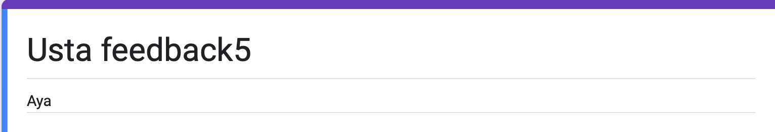

Slide 3
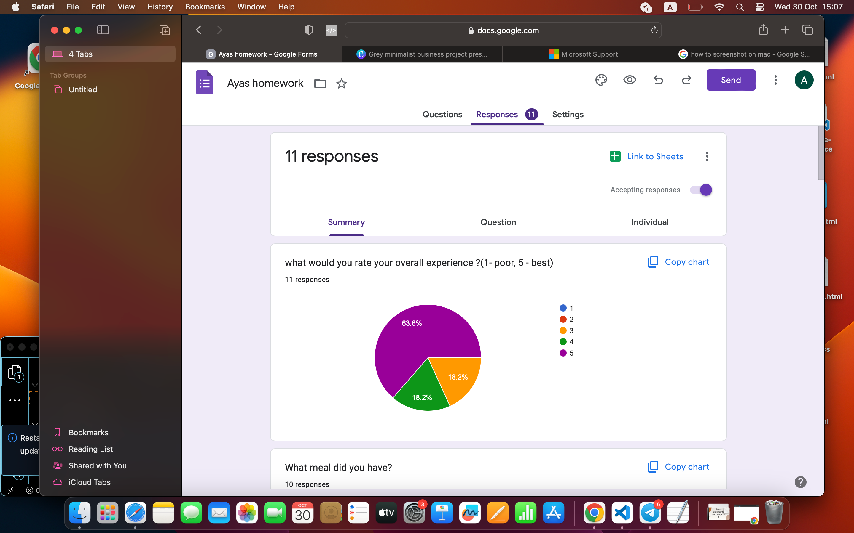

what would you rate your overall experience ?(1- poor, 5 - best)

Slide 4

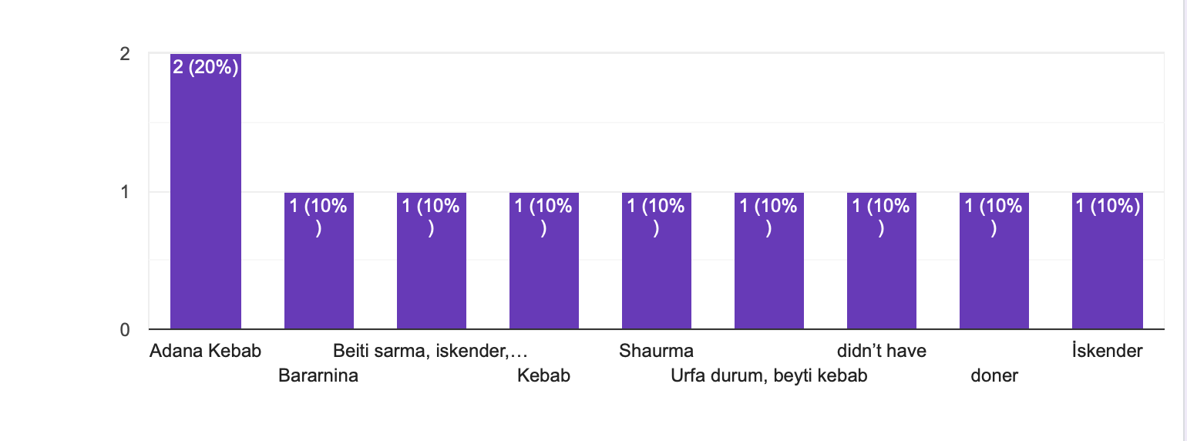
WHAT MEAL DID YOU HAVE?

Slide 5
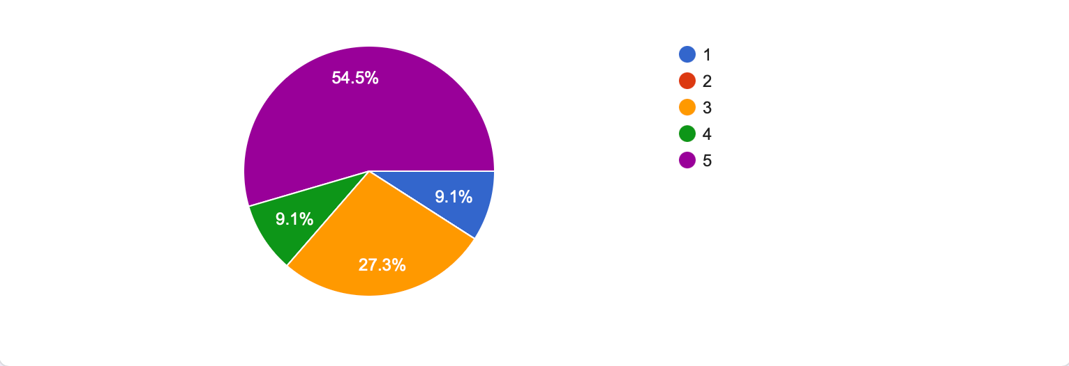
How would you rate the quality of our food(1-poor, 5-best)

Slide 6
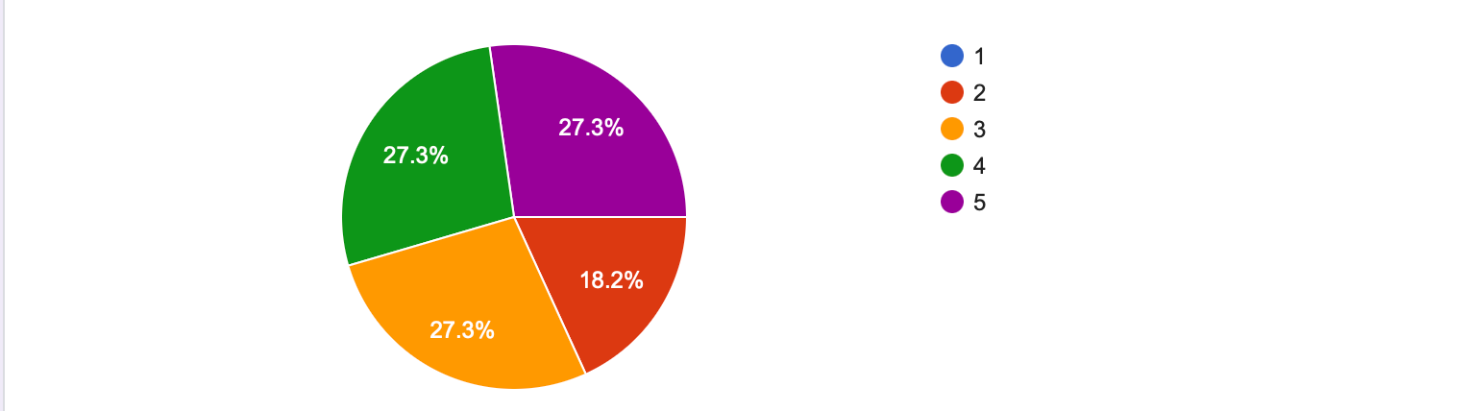
HOW WOULD YOU RATE THE SERVICES PROVIDED BY OUR STAFF?(1-POOR,5-BEST)

Slide 7
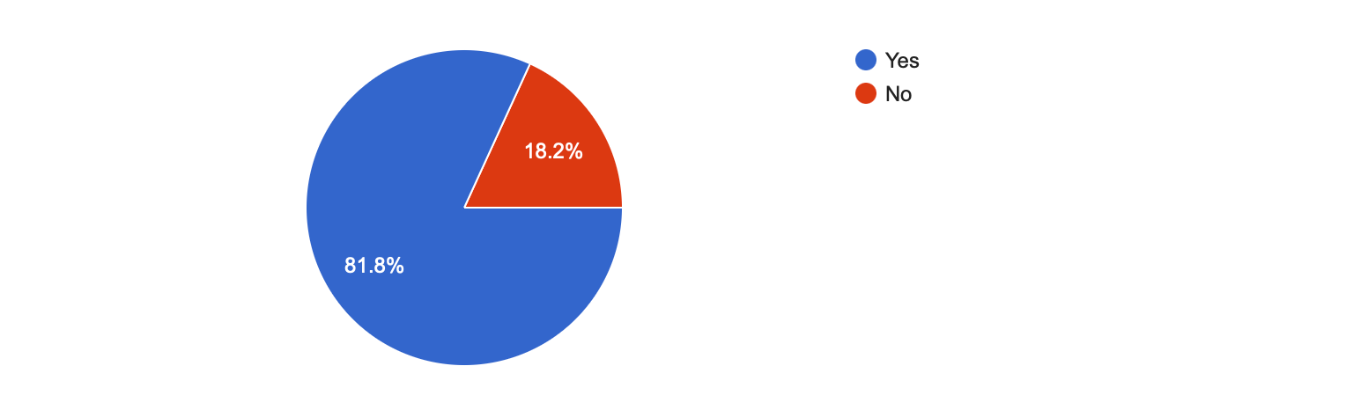
Was your food served promptly?

Slide 8

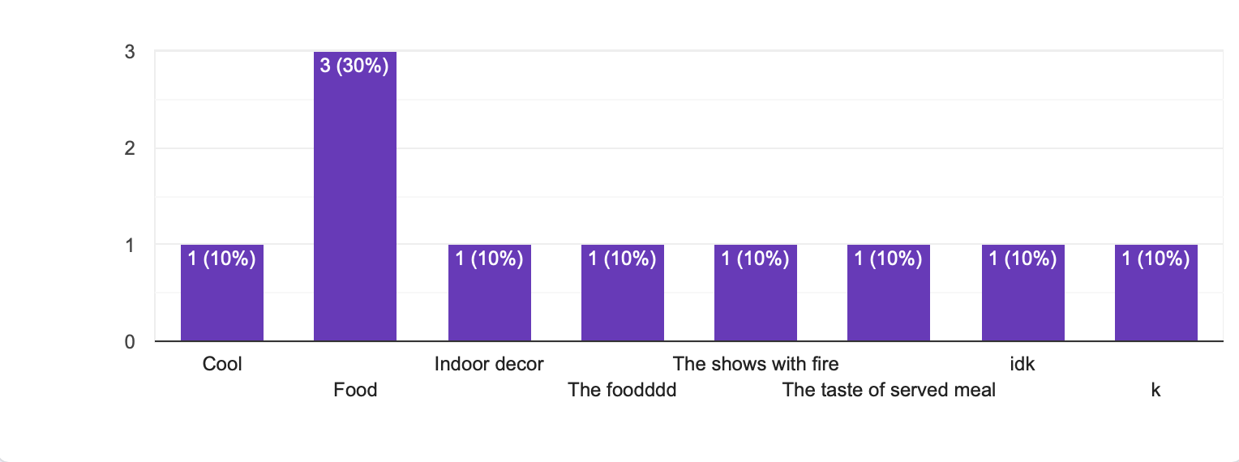

WHAT DID YOU ENJOY MOST ABOUT YOUR VISIT?

Slide 9

What could we improve?
LARANA, INC.

Slide 10
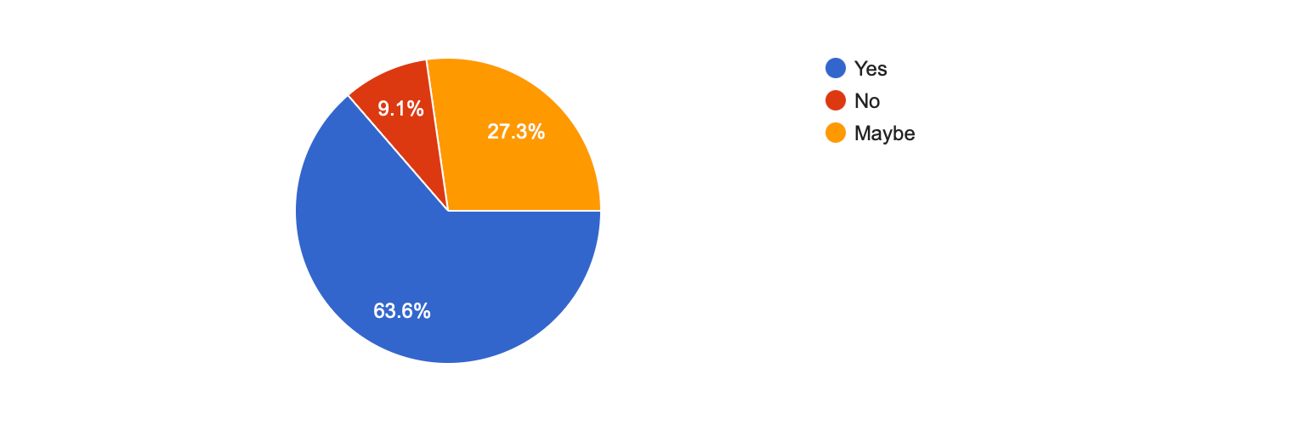
WOULD YOU RECOMMEND US TO OTHERS?

Slide 11
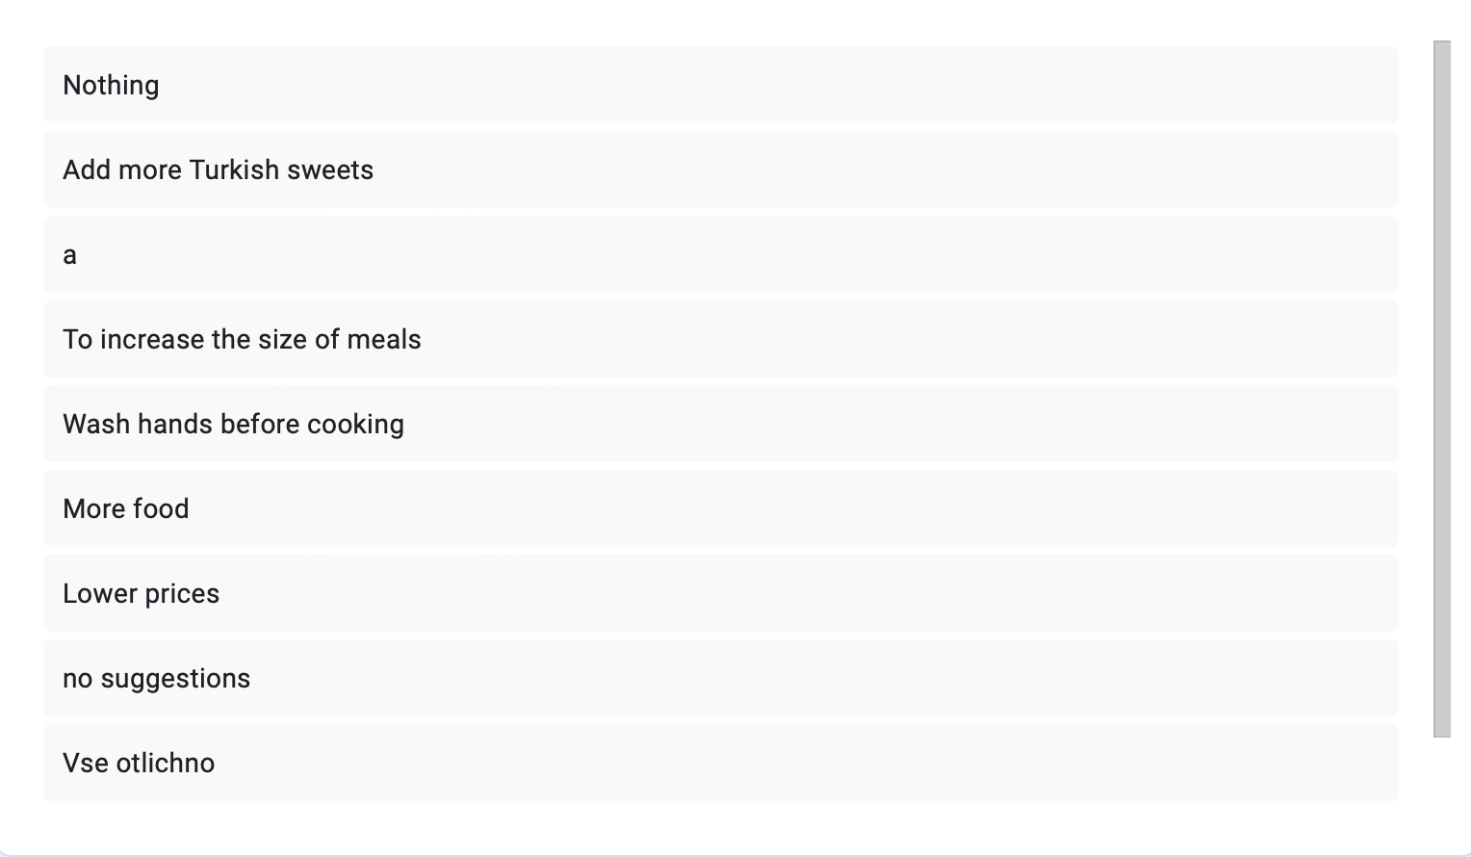
WHAT SUGGESTIONS WOULD YOU MAKE FOR OUR MENU?

Slide 12
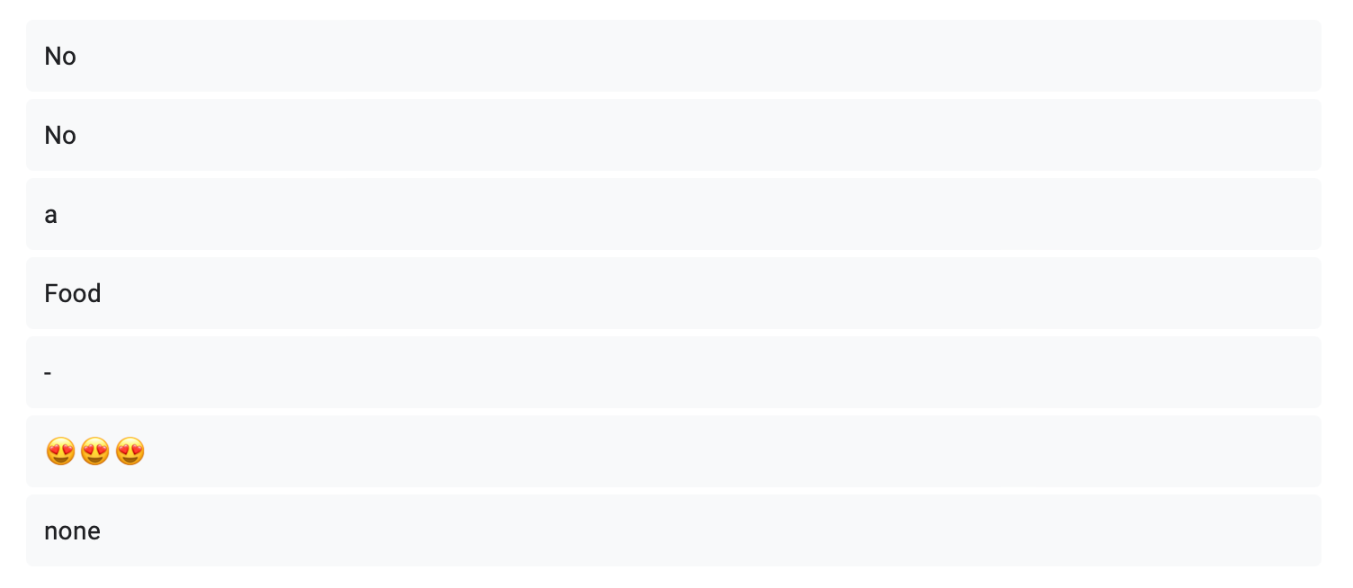
Any additional comments or suggestions?

